Slide 1

RCM360 – Healthcare Analytics Dashboard
Turning Healthcare Data into Actionable Insights
22/04/2025
1

Slide 2
Agenda
Purpose
Scope
Core Modules
Appointment Insights
Submission Insights
Payment Insights
Dashboard Highlights
Value to RCM360
Scalability & Fit
Future-Ready Features

Slide 3
Purpose
The RCM360 Dashboard is a Power BI solution designed to simplify healthcare billing and operations.
It integrates data from appointments, submissions, and payments into one seamless platform.
The goal: enable providers to work smarter, improve efficiency, and make faster, data-driven decisions.

Slide 4
Scope
Pulls data from leading systems:
EPIC - Appointment Reports
Office Ally - Submissions
ERA - Payments
Automatically cleans, merges, and analyzes this data.
Presents results through interactive dashboards and KPIs.

Slide 5
Core Modules
Appointment Reports
Track appointments, cancellations, no-shows, and slot utilization.
Compare performance by provider and location.
Submission Reports
Measure claim submission timelines.
Identify unsubmitted visits and analyze CPT usage.
Payment Reports
Monitor payment timelines, outstanding balances, and denial rates.
Understand insurer and provider-level payment patterns.

Slide 6
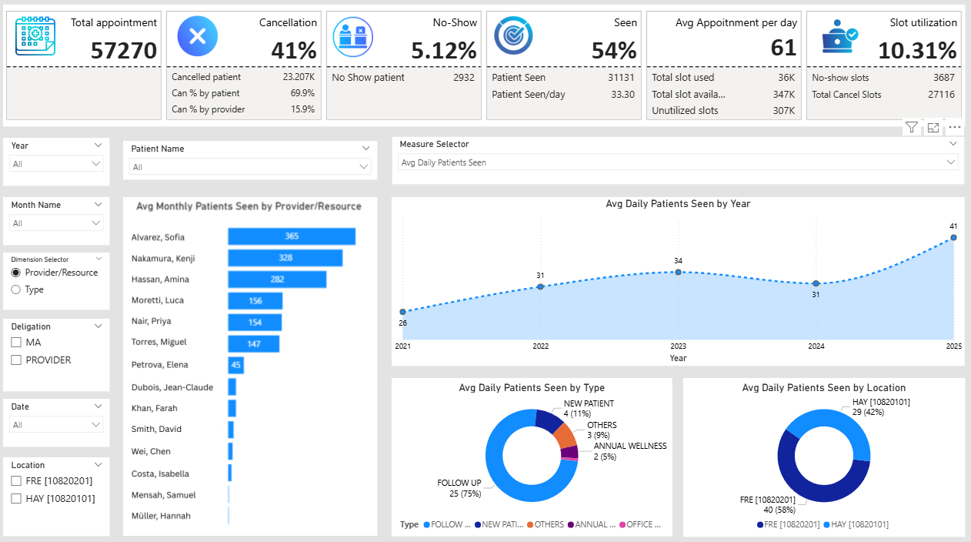
Appointment Insights
Total appointments and month-over-month trends.
Cancellation & no-show rates for better scheduling.
Slot utilization to track clinic efficiency.
Appointment mix: new patients, follow-ups, wellness visits.
Performance breakdown by provider and location.

Slide 7
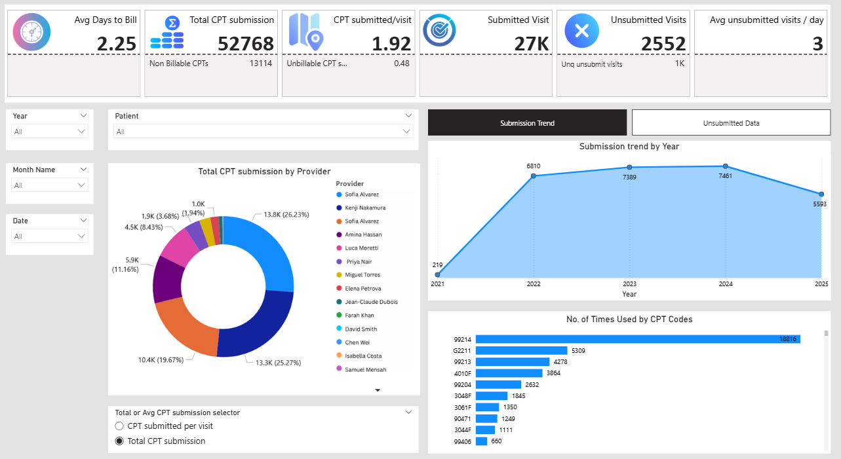
Submission Insights
Average time from visit to claim submission.
CPT code frequency and usage trends.
Submitted vs. unsubmitted visits at a glance.
Provider-level submission performance.

Slide 8
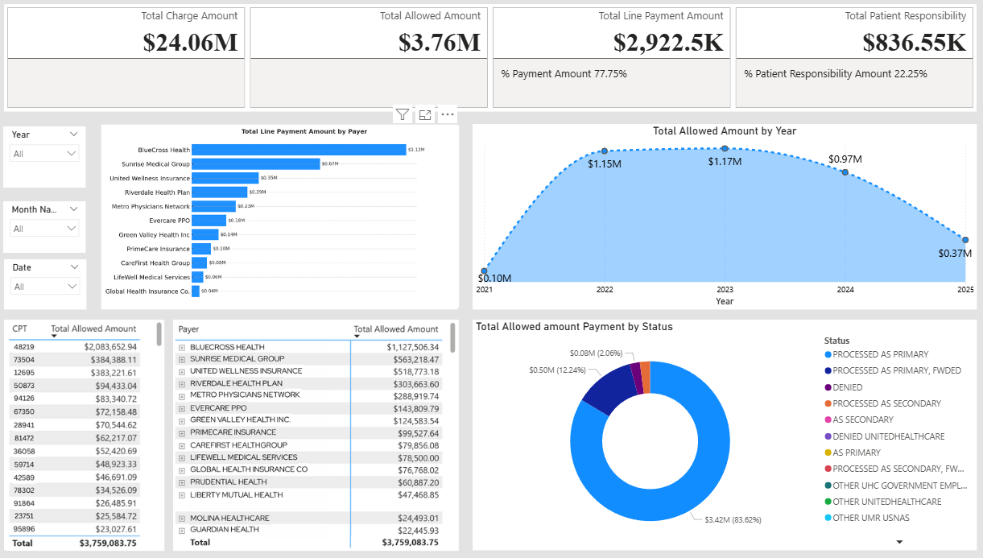
Payment Insights
Time taken from claim submission to payment.
Aging analysis: 0–30, 31–60, 61–90, 90+ days.
Patient vs. insurance collections.
Real-time view of outstanding balances and denial reasons.

Slide 9
Dashboard Highlights
Track revenue and cash flow trends.
Analyze claims and denials with root-cause insights.
Monitor outstanding balances and patient collections.
Gain CPT code-level insights across providers.
Benchmark provider productivity.
Understand insurance payment behaviors.
Use interactive filters to deep dive by date, provider, payer, or code.

Slide 10
Value to RCM360
Increases revenue by spotting underpayments and delays.
Saves time – reduces manual work for billing teams.
Supports payer negotiations with clear, data-backed insights.
Audit-ready – clean, structured reporting for reviews.
Improves collections by identifying pending balances early.

Slide 11
Scalability & Fit
Why it works well:
Built specifically for healthcare finance and billing.
Easy adoption – uses existing reports.
Works across Medicare, Medicaid, and private insurers.
Supports multi-location and multi-provider practices.
Who benefits most:
Clinics and hospitals.
Independent medical practices.
Billing companies.
Finance and admin teams.

Slide 12
Future-Ready Features
Provider scorecards for billing and revenue performance.
Early warning for potential claim denials.
Email/SMS alerts for unpaid or overdue claims.
AI-based denial predictions to reduce revenue loss.
Comparative insights into best-performing insurance plans.

Slide 13
Thank You

